Slide 1
Kaon Experiment Optimization
K⁺→π⁺+π⁰
^{Ion Skalamera}
^{Oliver Oehlenberg}
^{Archimedes Wildhaber}
^{Alessandro Schutz}

Slide 2
Code overview
Everything is currently in a private GitHub repo
All scripts in the ./scripts folder
Data used in the report can be found in ./data/value_cache.json
Package management trivialized thanks to uv (total of 3 packages used, wow)
Reproducibility
Code adopts SPEC 7, meaning it uses numpy Generator instances
To reproduce the values, run ./scripts/generate.py with the seed found in ./data/entropy (which it does by default)
If that file is not found, it will save it to that location (by default, can be changed by command line arguments)

Slide 3
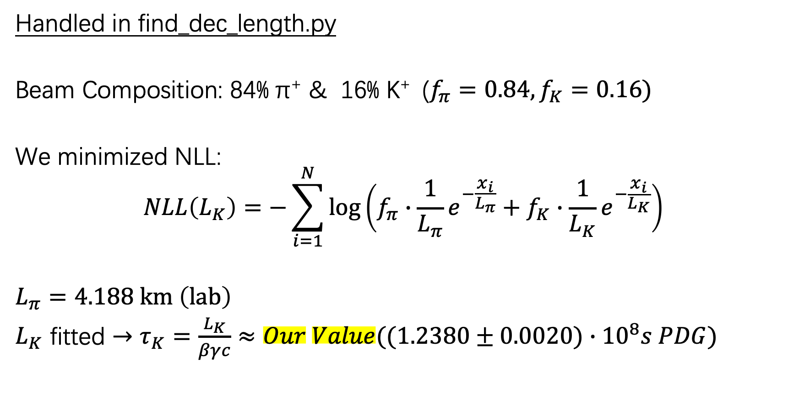
Task 1 : Determination of the average decay length of the K+
Handled in find_dec_length.py
Beam Composition: 84% π⁺ & 16% K⁺ ($f_{π}=0.84,f_{K}=0.16)$
We minimized NLL:
$$NLL\left(L_{K}\right)=−\sum_{i=1}^{N}{\log\left(f_{π}∙\frac{1}{L_{π}}e^{−\frac{x_{i}}{L_{π}}}+f_{K}∙\frac{1}{L_{K}}e^{−\frac{x_{i}}{L_{K}}}\right)}$$
$L_{π}=4.188 km \left(lab\right)$
$L_{K}$ fitted $→τ_{K}=\frac{L_{K}}{βγc}≈Our Value((1.2380±0.0020)∙{10}^{8}s PDG)$

Slide 4
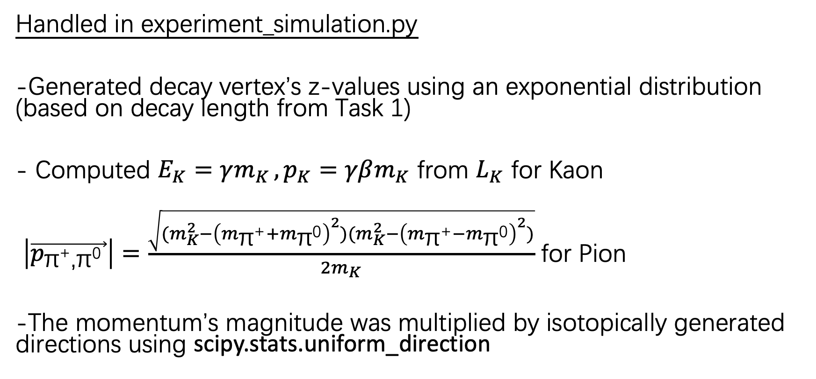
Task 2 : Generating Kaon decay sample
Handled in experiment_simulation.py
-Generated decay vertex’s z-values using an exponential distribution (based on decay length from Task 1)
- Computed $E_{K}=γm_{K }, p_{K}=γβm_{K}$ from $L_{K}$ for Kaon
$\left|\vec{p_{\text{π}\text{+}\text{,}\text{π}\text{0} }}\right|=\frac{\sqrt{{(m}_{K}^{2}−{\left(m_{\text{π}\text{+}}+m_{\text{π}\text{0}}\right)}^{2}){(m}_{K}^{2}−{\left(m_{\text{π}\text{+}}−m_{\text{π}\text{0}}\right)}^{2})}}{2m_{K}}$ for Pion
-The momentum’s magnitude was multiplied by isotopically generated directions using scipy.stats.uniform_direction

Slide 5
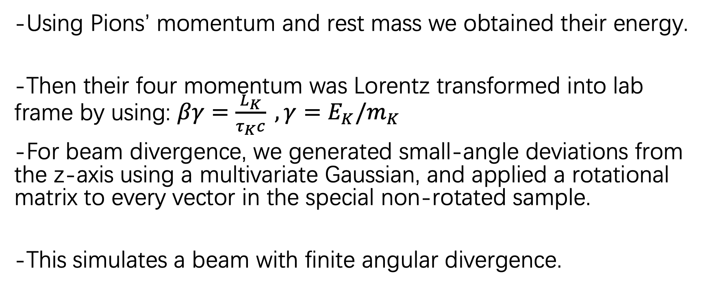
Task 2/3 : Lorentz Boost & Rotation
-Using Pions’ momentum and rest mass we obtained their energy.
-Then their four momentum was Lorentz transformed into lab frame by using: $βγ=\frac{L_{K}}{τ_{K}c} ,γ=$ ${E_{K}/m}_{K }$
-For beam divergence, we generated small-angle deviations from the z-axis using a multivariate Gaussian, and applied a rotational matrix to every vector in the special non-rotated sample.
-This simulates a beam with finite angular divergence.

Slide 6
Task 2/3: Optimization
Handled in intersection.py
-Assumption: Decay behind the detector won’t trigger events
-For a given z for detector, number of intersection of detector and pion trajectories was computed. And then used scipy.optimize.minimize_scalar to optimize(minimize the negative of that).
-The intersection-calculating code is then generalized to handle both the general case and the special non-rotated example.

